Slide 1
SIMPLICITY
The technical style demands formal yet simple language.
Use technical words only when you really need to.
Avoid unnecessary jargon.

Slide 2
SIMPLICITY
Saying things as simply as possible…
Can be achieved through;
.
Sentence structure
Vocabulary
Length
Use simple sentences
Avoid fancy/arcane vocabulary
Keep sentences limited to 8-/-12 words

Slide 3
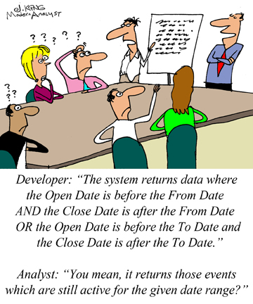
Simple Sentence

Slide 4
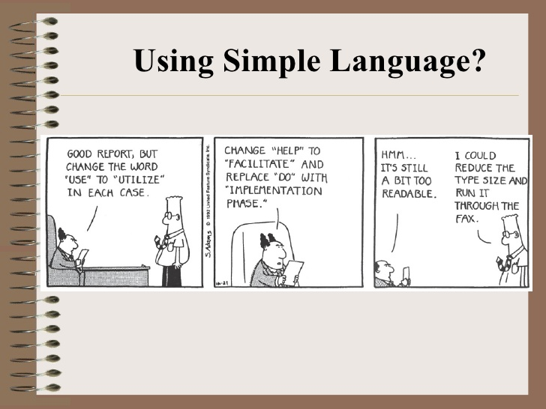
Vocabulary

Slide 5
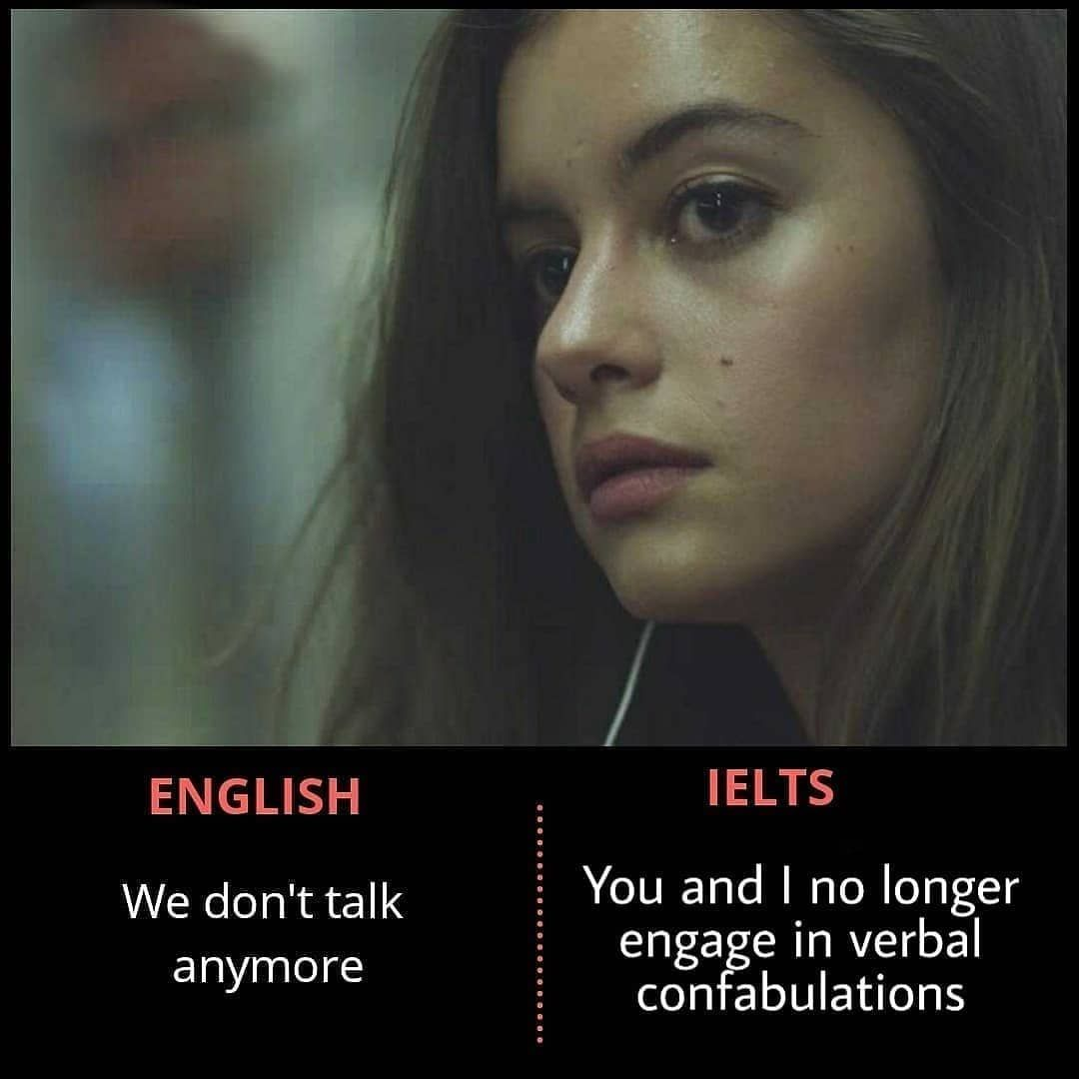
Vocabulary-Use common words

Slide 6
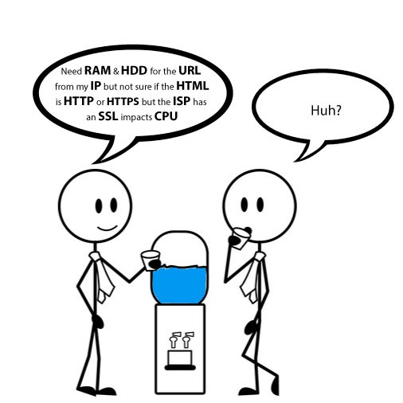
Vocabulary-Avoid Jargon

Slide 7
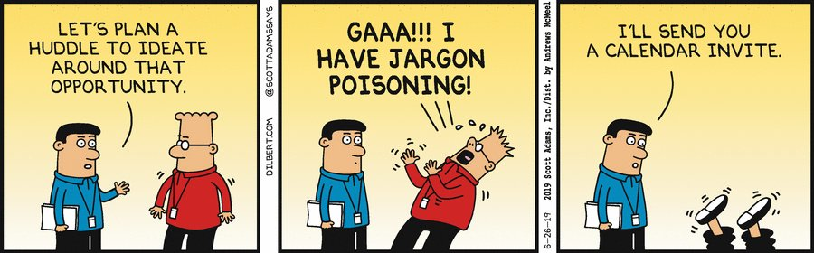

Slide 8
Length
“If, for a while, the ruse of desire is calculable for the uses of discipline, soon the repetition of guilt, justification, pseudo-scientific theories, superstition, spurious authorities and classification can be seen as the desperate effort to ‘normalise’ normally the disturbance of a discourse of splitting that violates the rational enlightened claims of its enunciatory modality.” (Homi Bhaba,Post-Colonial theorist)

Slide 9
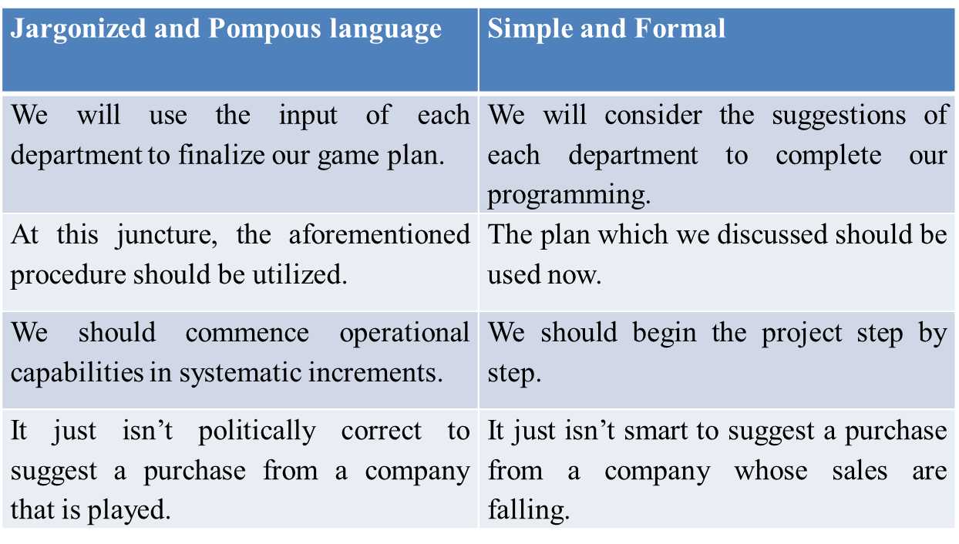
Sample

Slide 10
Re-write the following sentences by making
them simple and reader friendly.
Last but not least, the article sends an important message.
My main ambition in life is not to make a fortune, since I know that, as they say, "Money is the root of all evil."
For Baldwin, the problem never reared its ugly head until one dreadful night in New Jersey.
The building's owners offered the inspectors many financial incentives to overlook code violations

Slide 11
OBJECTIVITY
‘Subjective’ refers to information that is based on personal opinions
‘Objective’ refers to information that is based on factual evidence

Slide 12
OBJECTIVITY-Strategies to achieve objectivity
Use impartial language, which is not
Personal
Judgmental
Emotive

Slide 13
OBJECTIVITY- Personal Language
1.Avoid personal language unless necessary. Compare the examples below:
1. I got informed consent in accordance with the procedures specified for research
Informed consent was obtained in accordance with the procedures specified for
research
2. I believe that there is a discrepancy between theory and practice…
Research suggests that there is a discrepancy between theory and practice
3. I interviewed a total of 22 parents during the month of December 2009…
A total of 22 parents were interviewed during the month of December 2009…
4. I gave completed questionnaires a number for identification purposes…
Completed questionnaires were allocated a number for identification purposes…

Slide 14
OBJECTIVITY-Judgmental Language
2. Avoid Judgmental Language.
Judgmental language suggests that you are making a personal judgment.
By using judgmental language, it may sound as
though you have come to a conclusion based on your previously held beliefs, rather than through a review of
the relevant literature.
It is important to remember that beliefs you may have held at one time could later be disproved.

Slide 15
OBJECTIVITY-Avoid Judgmental Language
International schools are always elitist…
International schools are often viewed as elitist…
2. Jessen’s (1956) theory is the most influential for scholars in education
Jessen’s (1956) theory remains one of the most influential for scholars in education…
3. Smith’s (2009) paper made such a remarkable contribution to the field…
Smith’s (2009) paper made a major contribution to the field…
4. Gorard’s (1999, pp.31-33) study provided an awesome classification
Model.
Gorard’s (1999, pp.31-33) study provided a concise classification
Model.

Slide 16
OBJECTIVITY-Emotive Language
Emotive language appeals to the emotions or values of your reader.
Emotive language tends to use superlatives and/or exaggeration in an attempt to incite an emotional reaction

Slide 17
OBJECTIVITY-emotive language
Japanese orthography is too difficult to be well-understood…
Japanese orthography is not generally well-understood…
These really lucky people may be advantaged by healthcare
services that…
These people may be advantaged by healthcare services that…
3. Sydney represents an incredibly vivacious school market…
Sydney represents an active and dynamic school market…

Slide 18
Make objective
I don’t think that this company cares about
what their customers think of them.
In my experience, they haven’t been the best.
This operating system isn’t the best one out
there, it’s too slow for most people’s needs.

Slide 19
Re-write the following and make it objective
Our lives at home converged around the pleasantly-shaped kitchen table. It was
the magnet that drew our family together quite warmly. Cut from the sturdiest
oak, the table was tough, smooth, and long enough for my mother, my two
sisters, and me to work or play on at the same time. Our favorite light blue
ceramic tile, stationed in the right corner, was the table's sole defense against
the ravages of everything from a steaming teapot to the latest red-hot gadget
from the Sears catalogue. More often than not, however, the heat would spread
quickly beyond the small tile and onto the checkered oilcloth, which just as
quickly exuded a rank and sour odor. Yet no matter how intensely the four of us
competed for elbow room at the table, none dared venture near the lone dinner
place arranged securely to the left of the tile. There was no telling when he
would get home from work, but, when he did, he expected the food to be ready-
-steaming hot. He liked to eat right away--steak mostly--two bloody but thick
pieces.

Slide 20
Objective version
The kitchen table is rectangular, seventy-two inches long and thirty
inches wide. Made of a two-inch-thick piece of oak, its top is covered
with a waxy oil-cloth patterned in dark red and blue squares against a
white background. In the right corner, close to the wall, a square blue
ceramic tile serves as the protective base for a brown earthenware
teapot. A single white placemat has been set to the left of the tile, with a
knife and fork on either side of a white dinner plate, around nine inches
in diameter. On the plate are two thick pieces of steak.

